Slide 1


GM INSTITUTE OF TECHNOLOGY
DEPARTEMET OF COMPUTER SCIENCE AND ENGINEERING
Internship Presentation on:
Anti-Poaching Alarm System for Tree
GUIDE :
PRESENTED BY:
Mr. Sandeepa G S
Associate Prof.
CSE, GMIT
Rahul D R 4GM21CS075
Srujan K S 4GM21CS109
Vedanth K N 4GM21CS118
Yathish Rao M R 4GM21CS126

Slide 2

Anti-Poaching Alarm System for Tree
IoT Internship

Slide 3
Table of Contents
01
02
03
04
Company Profile
Introduction
Software Requirement
Project

Slide 4
01
Company

Slide 5

SIRINTEL TECHNOLOGY
Sirintel is a leading upcoming Information Technology (IT) Service provider who delivers the complete solution for the entire software necessities with the assured quality

Slide 6
02
Introduction

Slide 7

About IoT

Slide 8
INTERNET OF THINGS [IOT]
The Internet of Things (IoT) refers to the interconnection of everyday objects and devices via the internet, enabling them to collect, share, and act on data.
IoT allows for seamless communication between devices, creating a smart ecosystem that enhances efficiency, automation, and convenience.

Slide 9
03
Software Requirement

Slide 10
Arduino IDE
Code Editor
Board Manager
Library Manager
Serial Monitor

Slide 11
Blynk Software
Blynk is an IoT platform that allows to build custom mobile apps to control and monitor Arduino-based projects remotely.
It provides a user-friendly mobile app available on iOS and Android that lets we design a graphical interface for our project using various widgets like buttons, sliders, and more.
Blynk uses the Internet to establish communication between the Blynk app and our NodeMCU board.

Slide 12
04
PROJECT

Slide 13
Problem Statement
Anti-Poaching Alarm System for Tree
Illegal Logging and Poaching
The high demand for Indian sandalwood has led to its scarcity, prompting the Indian government to restrict its exportation.
Need for Surveillance and Monitoring
The existing methods forest protection often require guards to travel throughout ofthe forest, making it difficult to cover vast areas effectively.

Slide 14
OBJECTIVES
The goal of the project is to prevent poaching, illegal logging, and other human-induced activities in the forest.
The proposed system can be implemented in any forest area that is highly affected by poaching and illegal cutting.
The system eliminates the need for guards to physically patrol the entire forest. Instead, the base station can receive visuals of all the activities happening in the forest.

Slide 15
METHODOLOGY
Sensor Network
Microcontroller Unit
Remote Monitoring
Data Transmission
Data Analysis and Alert System

Slide 16
PROPOSED SOLUTIONS
Implementation of a Sensor Network
Data Analysis and Insights
Integration with Microcontroller
Data Transmission and Visualization

Slide 17
BLOCK DIAGRAM
POWER
BUZZER
Accelerometer
Sensor
ESP8266
NodeMCU
LED
ANDROID APP

Slide 18
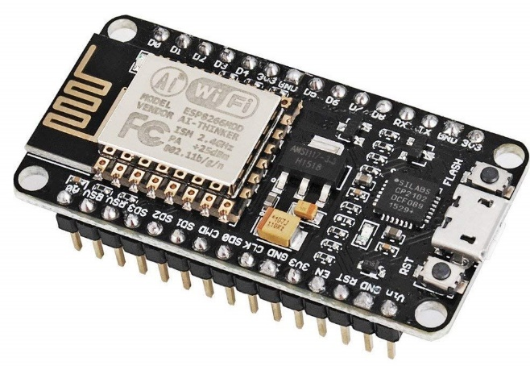
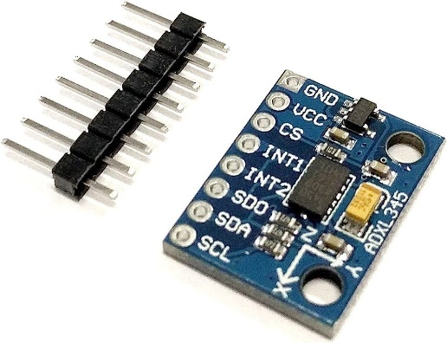


Components
ESP8266 Node MCU
A low-cost Wi-Fi microcontroller module used for IoT projects and wireless communication.
ACCELEROMETER
A sensor that measures acceleration in three axes, commonly used in motion-sensing applications.
BUZZER
An electronic sound-making device that produces a simple buzzing or beeping sound.
LED (Light Emitting Diode)
A semiconductor device that emits light when an electric current passes through it, often used for indicators or lighting purposes.

Slide 19
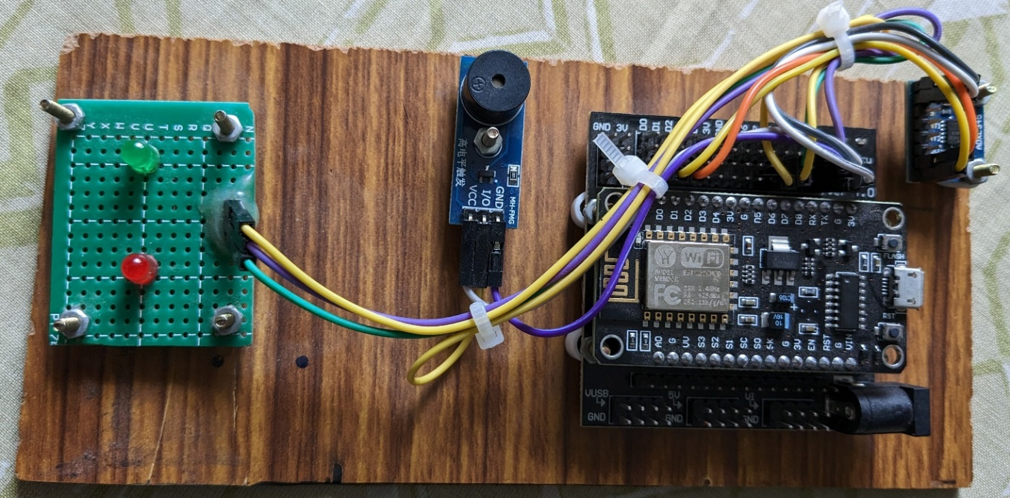
PROPOSED SYSTEM AND METHODOLOGY

Slide 20
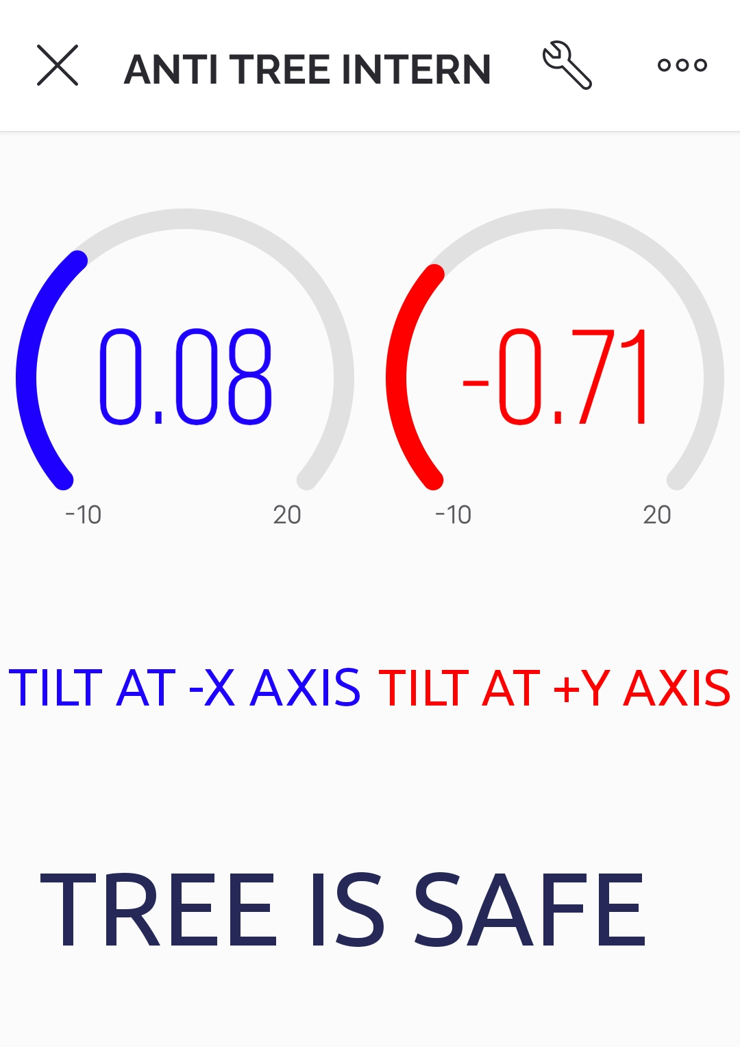
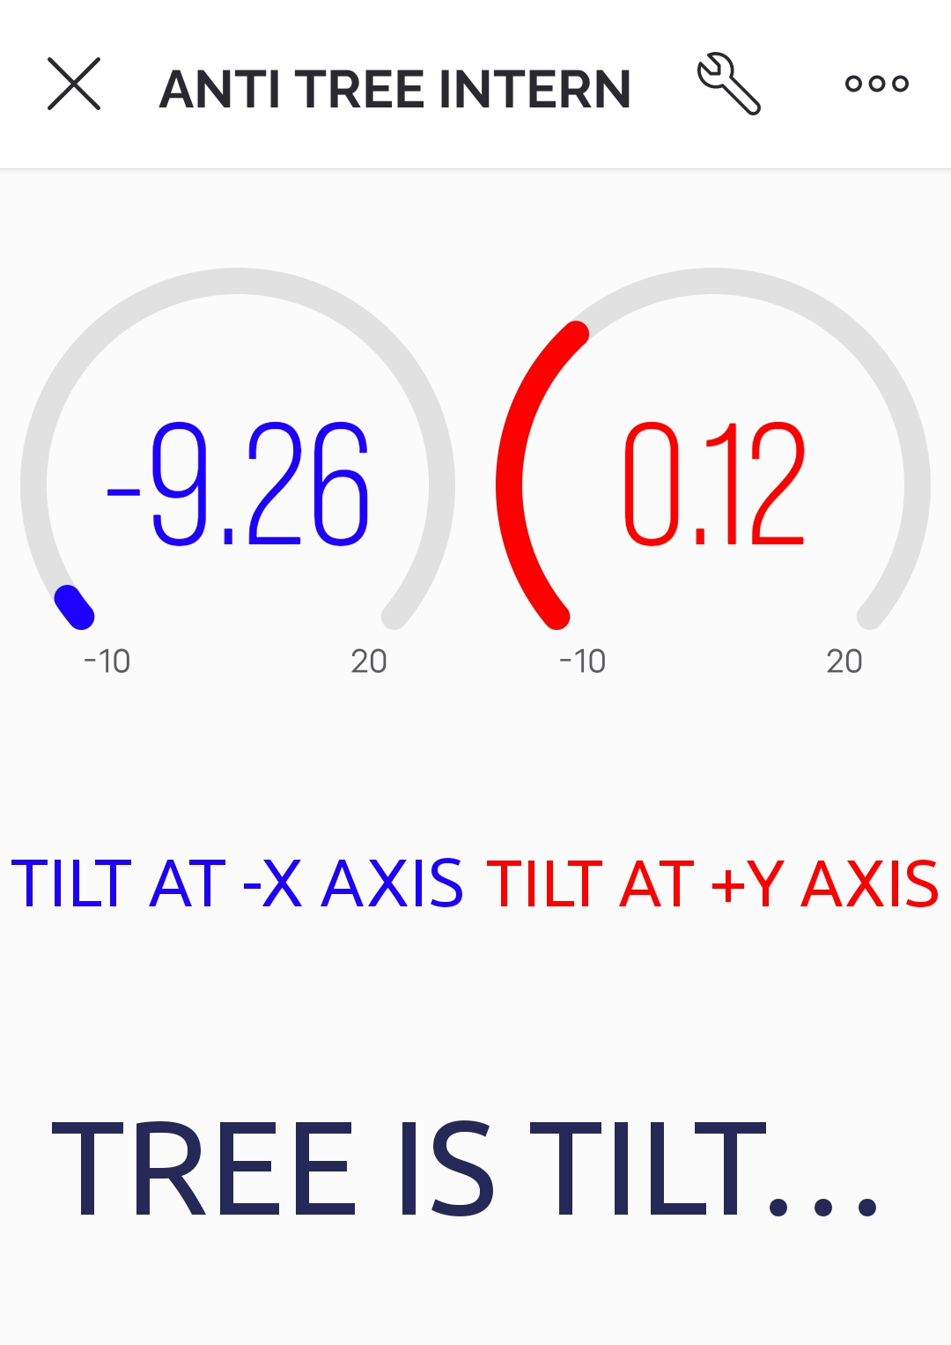
RESULT

Slide 21
ADVANTAGES
Early Detection
Real-Time Monitoring
Cost-Effective
Low Power Consumption

Slide 22
LIMITATIONS
Connectivity Issues
False Alarms
Limited Coverage

Slide 23
CONCLUSION
The IoT-based anti-poaching alarm system for trees represents a promising solution to combat illegal activities in forests.
By leveraging real-time monitoring and data analytics, it enhances early detection and rapid response, bolstering forest protection efforts and contributing to the preservation of valuable ecosystems.

Slide 24
Thanks!

